Slide 1

IMAP Program:
Youturn Health Overview
July 2025
This presentation contains confidential and proprietary information and may not be shared or distributed without the written consent of Youturn Health. Confidential © 2025 Youturn Health, Inc. All rights reserved.

Slide 2
Agenda:
1. Introductions
2. Do we have a problem?
3. Do we want to solve the problem?
4. What is changing about IMAP and why?
5. What is the solution?
6. What we need from you?
7. Discussion
This presentation contains confidential and proprietary information and may not be shared or distributed without the written consent of Youturn Health. Confidential © 2025 Youturn Health, Inc. All rights reserved.

Slide 3

Mental Health
A state of well-being in which every individual realizes their own potential, can cope with the normal stressors of life, can work productively and fruitfully, and is able to contribute to their community (WHO, 2020)
Our mental health influences:
      How we think
      How we act
      How we feel
      How we manage stress
      How we relate to other people

Slide 4
Construction Numbers
1 in 5 Americans will experience a mental health challenge at some point in their lifetime (CDC, 2023)
Men account for 3.5 times the number of suicides compared to women (NAMI, 2018)
The construction industry has one of the highest rates of suicide (CDC, 2020)
90% of people who die from suicide have experienced a mental health concern/condition (e.g., depression, anxiety, substance use, PTSD)
  Majority are not engaged in services (NAMI, 2023)

Slide 5

Being tough and strong are emphasized and highly valued
Deadline-driven work
Cultural Influences of the Construction Industry
Generational differences in the workforce
Long hours and time away from family
Financial strain (e.g., seasonal work, inconsistency)
Chronic pain from highly physical nature of the work

Slide 6
Program Overview
This presentation contains confidential and proprietary information and may not be shared or distributed without the written consent of Youturn Health. Confidential © 2025 Youturn Health, Inc. All rights reserved.

Slide 7
Gaps in the Treatment of Behavioral Health
Asking for Help
Only a small percentage of individuals ever reach out for help
What about the individuals and family members who are struggling and will never reach traditional treatment?
Family Support
Overall, the family is not well supported
The focus is primarily on the individual (which makes sense), but there is a tremendous need for family members to be supported as well
Engagement
75% of people who remain engaged (no matter what treatment modality) will reach recovery or remission
Problem: People do not remain committed and engaged in the process

Slide 8
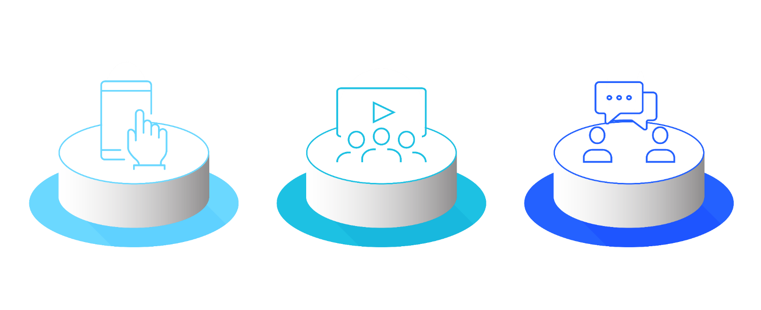
Engaging Content
Coaching Support
Family Support
Construction Trainings
45+ courses
500+ lessons
Confidential phone line
Available 24/7
Connect in the moment
Offer human-centered care
1:1 peer support coaching
Assertive Community Engagement
Family support is complimentary and includes specific marketing and engagement techniques to target family members.

Slide 9
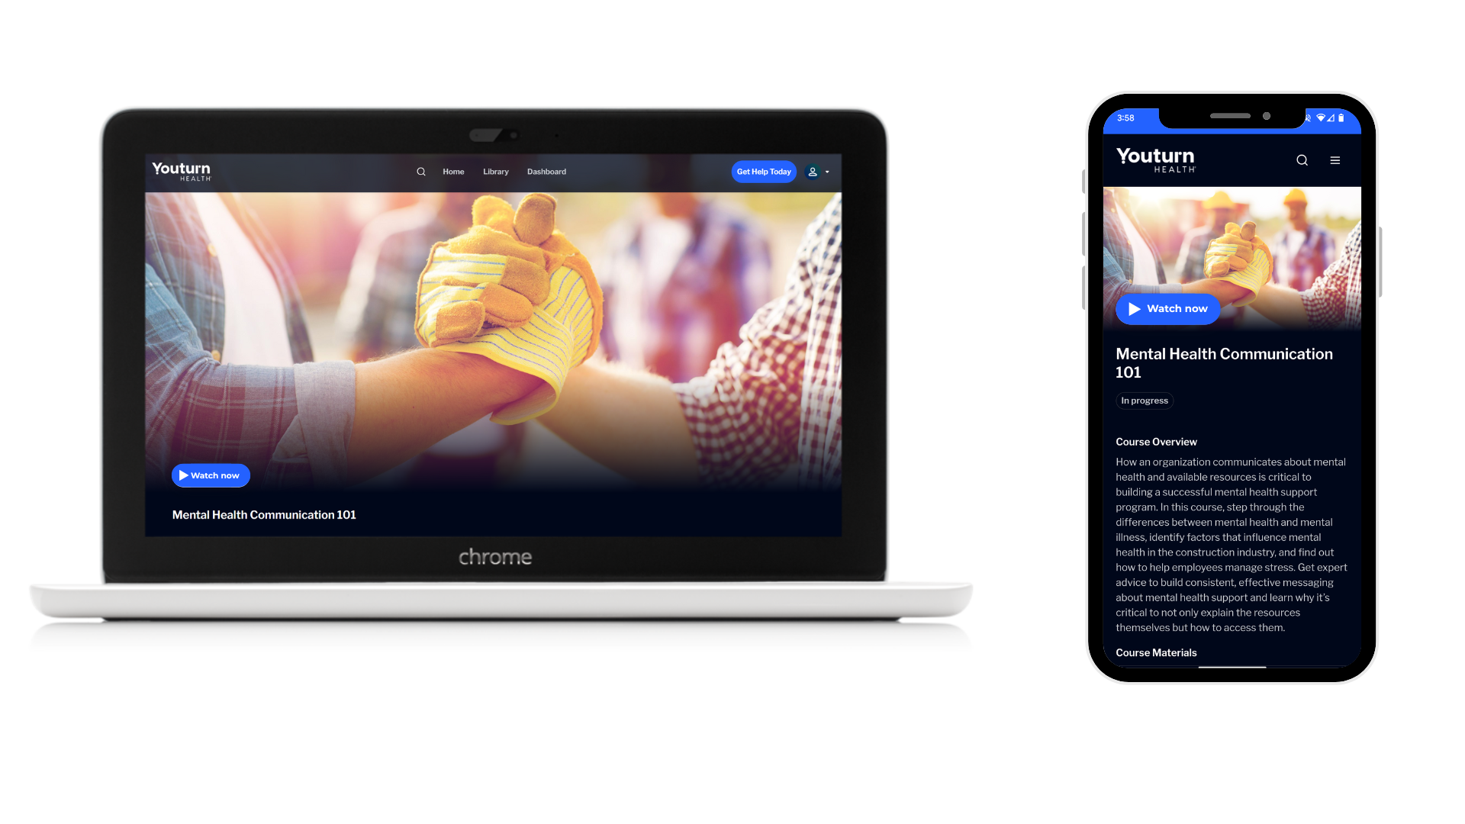
Construction-Specific Trainings
Mental Health Communication 101
Approaching Employees
Suicide: Prevention, Ideation, and Support
Recovery First Aid: Substance Use

Slide 10

Coaching Credentials
National Certification with NAADAC
Assertive Community Engagement (ACE)
Dedicated and Credentialed Family Coaches
Strategies
Overseen by coach managers and clinicians
Regular and consistent touchpoints
Referrals to providers and treatment
Participant and Family Engagement
Engagement
Paradigm shift: The professional is responsible for the engagement of the participant
ACE Peer Coaching &
Family Support

Slide 11
Leaders
HR & Safety
Individuals
Confidential Help
855-411-IMAP (4627)
Admissions@youturnhealth.com
Members will see the best results when Youturn Health becomes a part of daily conversations. When Leadership, HR, Safety, and Members all utilize Youturn Health, the conversations will change.
Use the IMAP number to:
Refer a Member
Receive Support
Ask a Question
Refer Family

Slide 12



The New Front Door: Youturn Health
855-411-IMAP (4627)
admissions@youturnhealth.com
now.youturnhealth.com/register
Registration code: IMAP
insulatorsIMAP.com

Slide 13
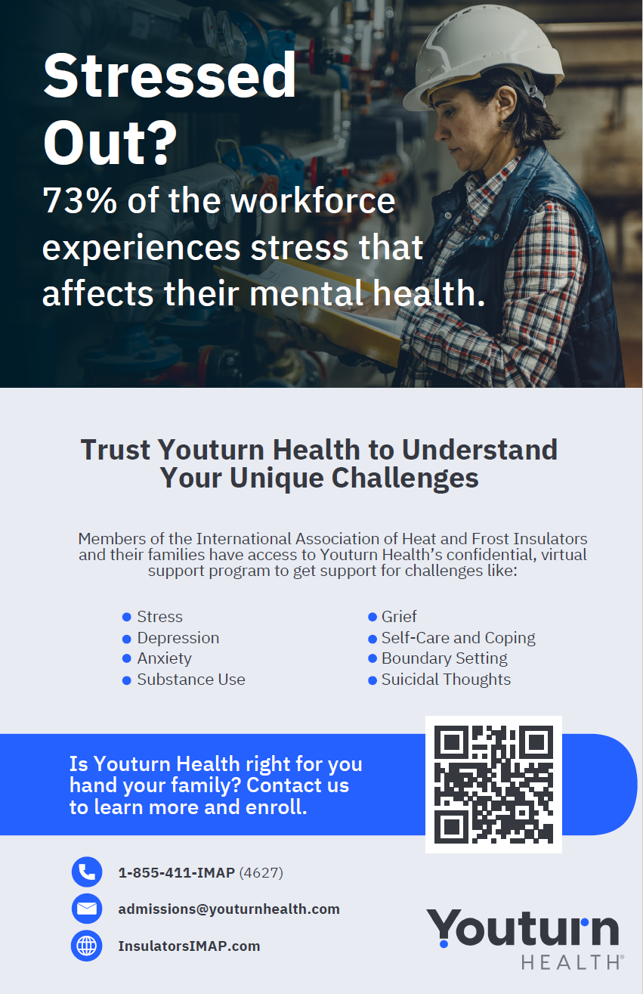



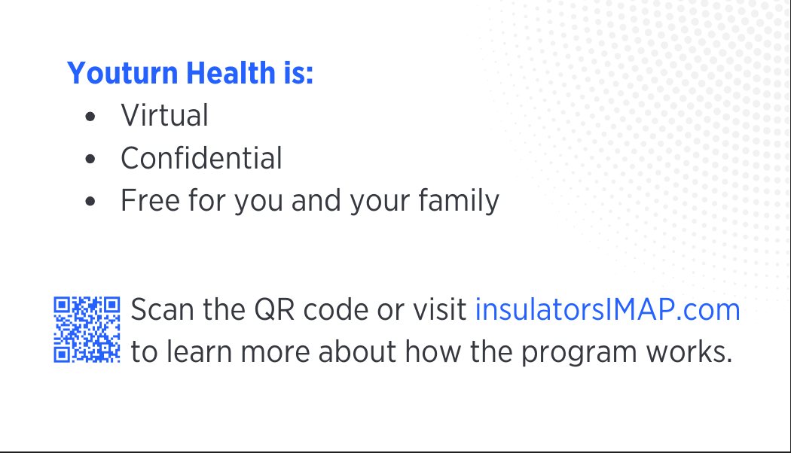
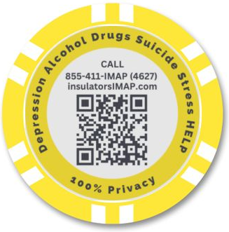
New Resources Coming to Your Local
(Front)
(Front)
(Back)
(Back)
Breakroom Posters
(Spanish &English)
Program Flyers
(Spanish &English)
Wallet Cards
(Spanish &English)
Poker Chips

Slide 14
Getting Through to Your Apprentices
Start Conversations Early
Assign or Ask for Mental Health Volunteers
Use Toolbox Talks for Mental Health (Youturn has some)
Make Support Visible
Provide Trainings
Track and Respond to Absenteeism Patterns
Offer Support

Slide 15
Making IMAP Part of Your Local’s Culture
This presentation contains confidential and proprietary information and may not be shared or distributed without the written consent of Youturn Health. Confidential © 2025 Youturn Health, Inc. All rights reserved.

Slide 16
IMAP Marketing Materials
(Front)
(Front)
(Back)
(Back)
Breakroom Posters
(Spanish &English)
Program Flyers
(Spanish &English)
Wallet Cards
(Spanish &English)
Poker Chips

Slide 17
Get in Touch
855-411-IMAP (4627)
admissions@youturnhealth.com
now.youturnhealth.com/register
Registration code: IMAP
insulatorsIMAP.com

Slide 18
Program Promotion:
What Will Work Best for Your Local?
For Members
For Families
In-person visits/Webinars
Flyers
Posters
Emails
Folders
Swag Items (poker chips, etc.)
Presenting at family events or meetings
Sharing print and/or digital materials
Hosting a virtual webinar/program overview

Slide 19

Newsletter
IMAP sends a monthly newsletter with materials for your app, communications, and social media. Scan the QR code below to sign up:

Slide 20
Contact Us
Rich Jones
Chief Clinical Officer
864-764-8504
rjones@youturnhealth.com
Hamilton Baiden
CEO
602-881-5389
hbaiden@youturnhealth.com
Bridget Kelly
VP
978-328-8787
bkelly@youturnhealth.com

